Slide 1

Unveiling FIFA
A DEEP DIVE INTO PLAYER DATA
Exploring Insights and Trends within the FIFA Dataset
DESIGN DREAMERS

Slide 2
Meet
OUR TEAM
KHUSHAL
SATHVIKA
22BTRAD019
22BTRAD024
CHETHAN
22BTRAD011

Slide 3
Table of
CONTENTS
01
02
03
INTRODUCTION
OVERVIEW
APPROACH
04
05
06
07
INSIGHTS GAINED
ANALYSIS
PREDICTIONS
CHALLENGES FACED

Slide 4


INTRODUCTION
FIFA, the Fédération Internationale de Football Association , the international governing body for football, oversees global competitions like the FIFA World Cup and works to promote the sport's growth and integrity worldwide. Established in 1904, FIFA plays a central role in organizing tournaments, setting rules, and fostering the values of teamwork and fair play in football.

Slide 5

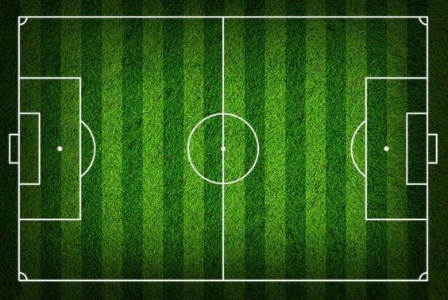

OVERVIEW OF THE DATA SET
Objective 1
Player Performance Evaluation: Analyzing player attributes to identify top performers and areas for improvement.
This FIFA dataset contains comprehensive information about football players, clubs, and various attributes related to the sport.
It encompasses player details such as name, age, nationality, overall rating, potential, position, and contract validity.
Additionally, the dataset includes club information such as name and total spending, as well as statistics on penalty taking, average skill scores, and player values.
This dataset offers valuable insights into the world of football, enabling analysis of player performance, club finances, and trends within the sport.
Objective 2
Financial Assessment: Evaluating club spending and player values to understand financial strategies and transfer market trends.
Objective 3
Penalty Taking: Investigating penalty-taking statistics to identify top performers and factors influencing success rates, aiding teams in optimizing penalty strategies and player selection.

Slide 6


APPROACH
STAGE 1
STAGE 2
STAGE 3
STAGE 4
After getting hands on the FIFA dataset and checking out its summary stats and structure. we noticed some inconsistencies and missing data, Spent some time cleaning it up, fixing errors, and handling missing values. Now, the data's all set for analysis, properly formatted
We explored the FIFA dataset, spotting key patterns, correlations, and trends. Then, we worked on transforming our findings into visually engaging charts and graphs, making it easy for everyone to grasp the insights we've uncovered.
The previously stated goals were kept in mind as the analysis and visualizations were completed.
We utilized Various Python libraries, including numpy and pandas at each stage, along with visualization tools such as matplotlib, seaborn, and plotly, to accomplish different aspects of the analysis and visualization process.

Slide 7
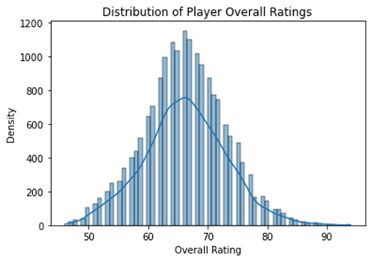
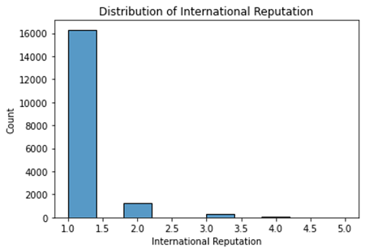
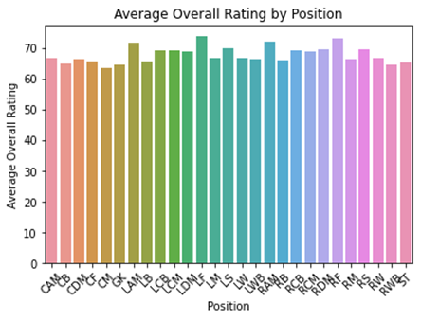
DISTRIBUTION OF OVERALL PLAYER RATINGS
This bar plot displays the average overall rating by player position
This histogram depicts the distribution of player overall ratings, showing the density of ratings across the dataset
There are fewer players with very high or very low ratings.
This graph shows how "international reputation" is spread across national teams.

Slide 8
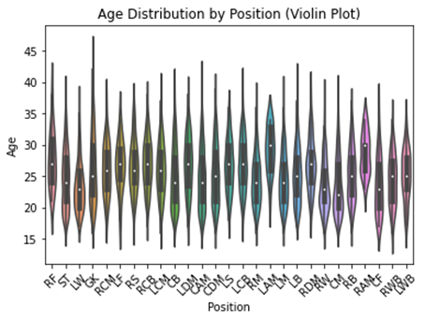
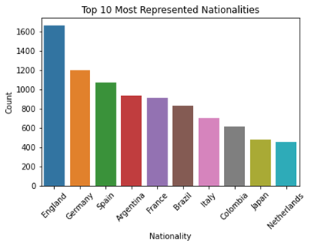
This plot is a bar chart showing the top 10 most represented nationalities among the players. Each bar represents a nationality, and its height corresponds to the number of players from that country
This plot is a violin plot illustrating the distribution of player ages across different positions. Each violin represents a player position, and its width indicates the density of player ages. The white dot in the center of each violin represents the mean age for that position

Slide 9

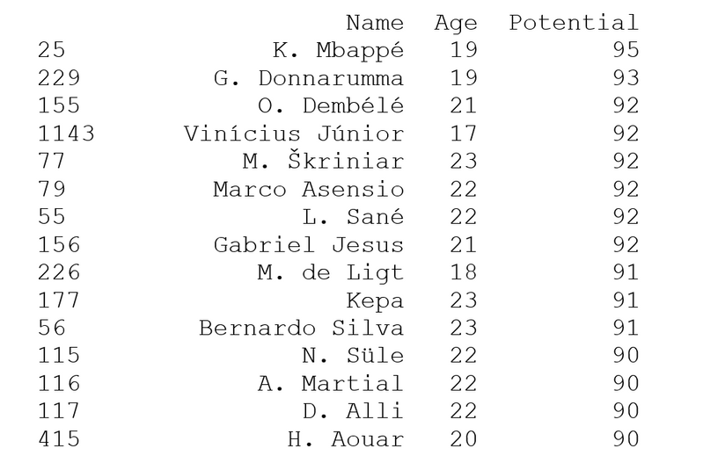
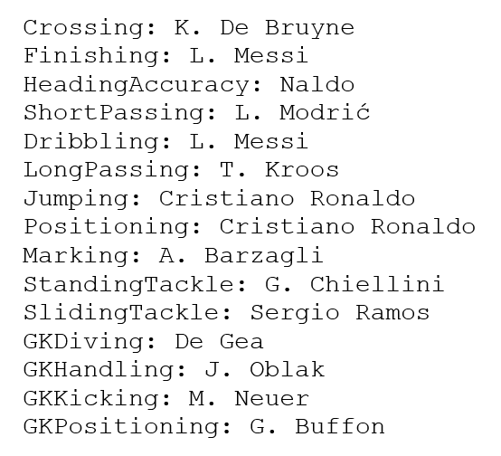
Player with Lower Age High Potential
Best Players In respec -tive Best Category
Best players in various categories are identified, including L. Messi for Finishing and Dribbling, Cristiano Ronaldo for Jumping and Positioning, and De Gea for GKDiving.
The list showcases young football talents with high potential, including K. Mbappé, G. Donnarumma, and O. Dembélé, among others, indicating promising futures in the sport.

Slide 10
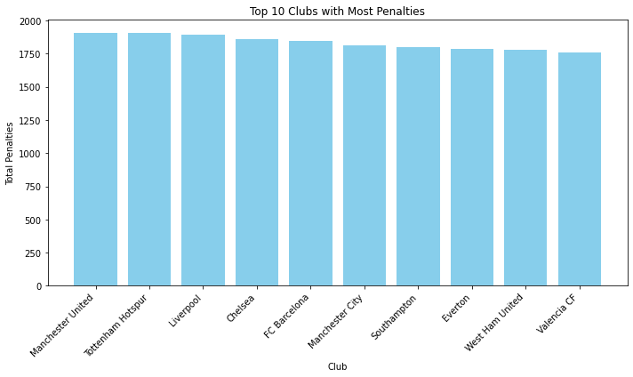
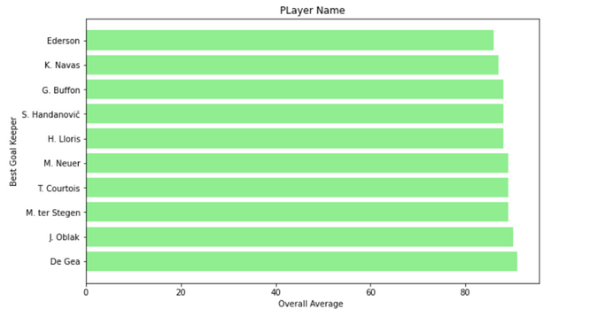
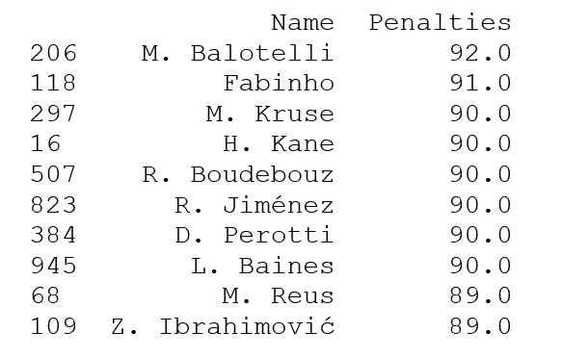
PENALTY HOTSPOTS
Number of Goals Per Clubs
Best GoalKeeper
Best PenaltyTaker Player

Slide 11
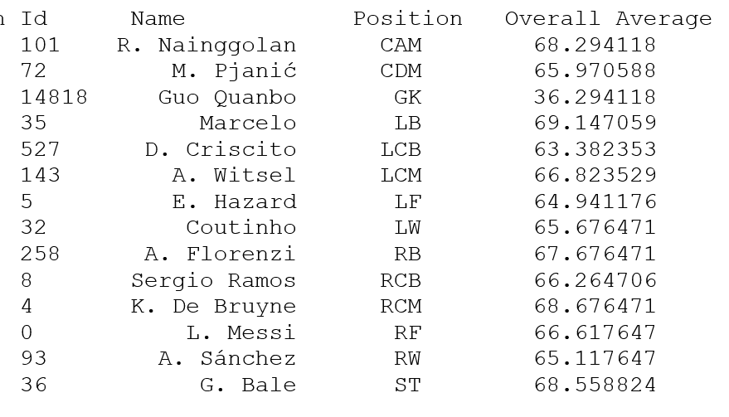
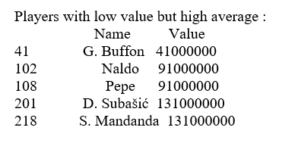
Best Player At Each Positon
Under Valued PLayer
Our analysis reveals the top performers across the pitch! Dive into the data and discover the elite players who dominate as Goalkeepers, Defenders, Midfielders, and Forwards.
The data suggests the presence of potentially undervalued players. These are players with a high average rating but a relatively low value.

Slide 12

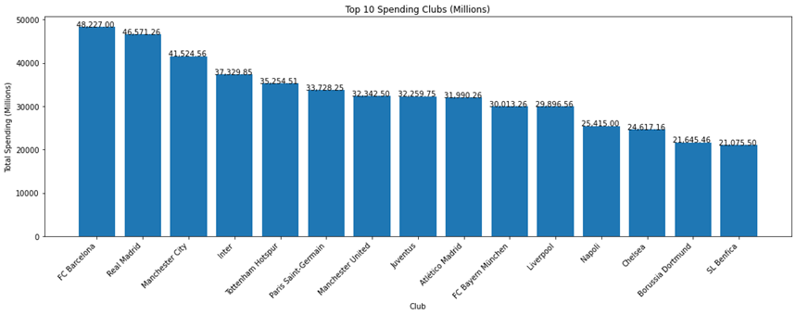
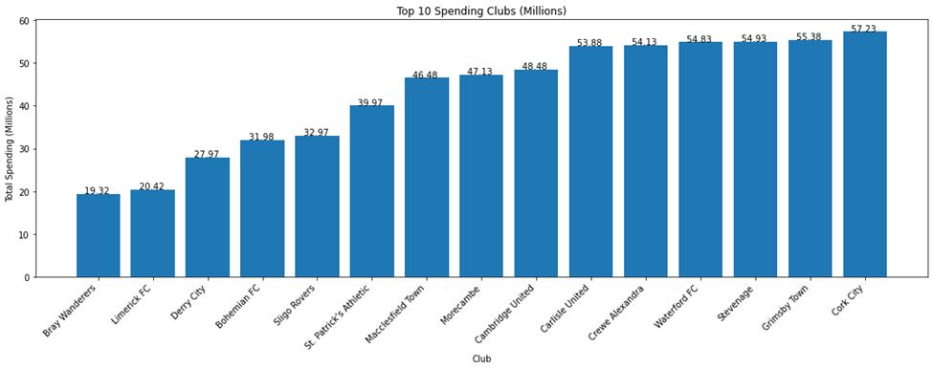
CLUB VALUATION
The data reveals a clear correlation between transfer spending and player value. Clubs like FC Barcelona and Real Madrid, known for their high spending, boast some of the most valuable players in the league. Conversely, teams with lower overall spending, such as Bray Wanderers and Limerick FC, have players with lower valuations.
Less

Slide 13
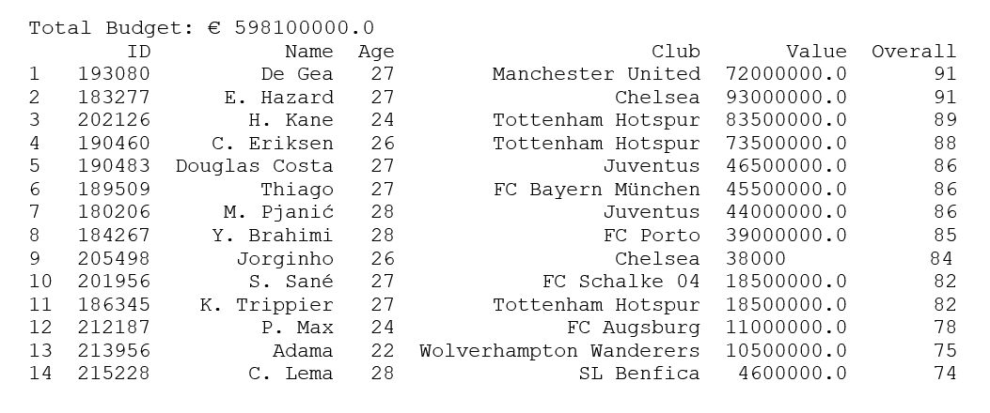
S
BEST TEAM
The best team under 30 with a budget of €598.1 million comprises players like De Gea, E. Hazard, and H. Kane, showcasing a blend of youth and experience from top European clubs like Manchester United, Chelsea, and Juventus, forming a formidable lineup capable of competing at the highest level.

Slide 14



CHALLENGES FACED
Incomplete datasets present a significant challenge as certain players are not considered for analysis due to missing data, leading to potential biases and incomplete insights into the overall landscape of the subject matter.
Handling multiple currencies (euros, millions, and thousands) for values such as wages and release clauses poses coding difficulties, adding complexity to the data processing and analysis stages, which may require additional effort to ensure accurate results.
While the provided FIFA dataset holds valuable player information, translating my analytical goals into effective code to unlock deeper insights regarding player dynamics and team management strategies remains a challenge.

Slide 15
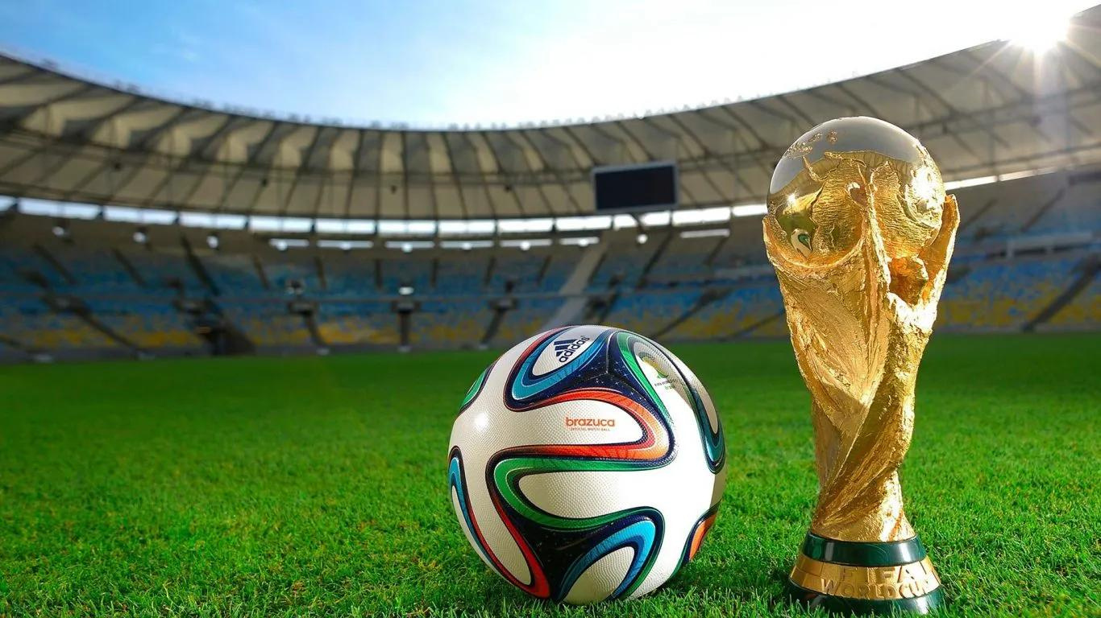

-DESIGN DREAMERS

